Slide 1
Chapter 8: Principles of Construction Design
Session II: Programming Design Language, Styles, and
Quality Evaluation in Construction Design

Slide 2
Session’s Agenda
Programming Design Language
Construction (Programming) Styles
  Formatting
  Naming
  Documentation
Quality Evaluation of Construction
  Completeness
  Correctness
  Testability
  Maintainability
McCabe’s Complexity Theory
  Used to evaluate testability and maintainability
What’s next…

Slide 3
Programming Design Language
Programming Design Language (PDL) is a form of pseudo-code used widely for designing internal function behavior.
  PDL's popularity stems from the use of natural languages—as opposed to computer languages or graphical techniques—to define the required behavior of functions.
  This result in detailed function designs that are easier to create, easier to review, and easier to translate to code.
The usage of a natural language in PDL provides a "comments first approach" to constructing code for any programming language.
  Therefore, PDL should be written without concern of the target programming language and detailed enough that code can be generated with minimal effort.
PDL can be used as both design technique and effective documentation approach for functions and code within functions.

Slide 4
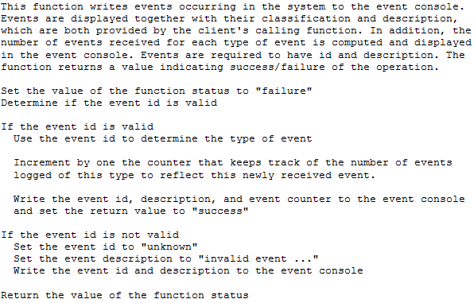
Programming Design Language
Example of PDL:

Slide 5
Software Construction using Styles
Construction styles are not about programming, but about defining the rules or guidelines for everyone in the project when writing the source code for a computer program.
As a general principle, construction styles must provide rules that ensure consistency, simplicity, and clarity of code.
Typical styles used during construction design include:
  Formatting Conventions
  Naming Conventions
  Documentation Conventions

Slide 6
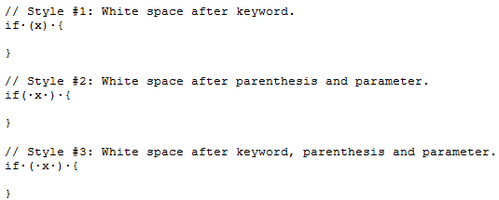
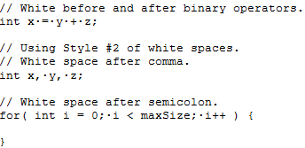
Software Construction using Styles
- Formatting Conventions -
Styles for Whitespaces To Separate Keywords, Parenthesis, and Curly Braces.
Styles for Whitespaces in Binary Operators, after Commas, and Semicolons

Slide 7
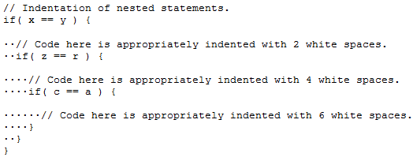
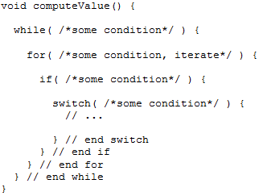
Software Construction using Styles
- Formatting Conventions -
Styles for Whitespaces in Nested Statements.
Matching Closing and Opening Brackets in Nested Statements.

Slide 8
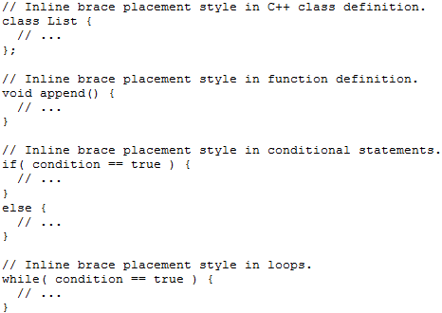
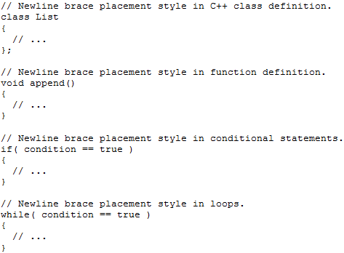
Software Construction using Styles
- Formatting Conventions -
Inline Bracket Placement Style.
New-line Bracket Placement Style.

Slide 9
Software Construction using Styles
- Naming Conventions -
Naming conventions can help programmers develop models for differentiating different aspects of software programs and maintain consistency through software items.
  This can in turn result in code that is self-documented by the use of conventions applied consistently in the code.
Naming conventions can be used to differentiate all elements that compose a software program; therefore, consistent use of naming style can help software teams to better understand the work done by each other.
When applied consistently, styles can easily help software developers, testers, and maintainers understand the code and make assumptions about it, based on the programming style.

Slide 10
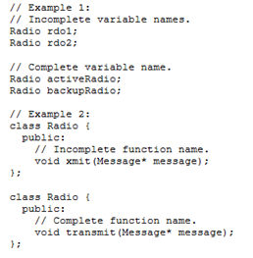
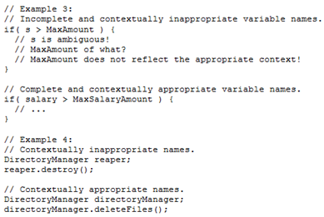
Software Construction using Styles
- Naming Conventions -

Slide 11
Software Construction using Styles
- Documentation Conventions -
Similar to formatting and naming conventions, documentation conventions can also be (almost universally) applied to projects in different domains and with different programming languages.
Documentation conventions deal with styles and specifications for what to document and how to document during construction.
  Generally, if the naming conventions are followed, comments should provide information that describes why an operation is written as opposed to what the operation is doing.
In many cases, the actions performed by operations (or blocks of codes) can be inferred from the naming conventions or programming syntax; however, the reasons behind the choice of code cannot be inferred as easily.
  Therefore, comments should provide the reasons why code was written, and when necessary, what the code is doing.

Slide 12
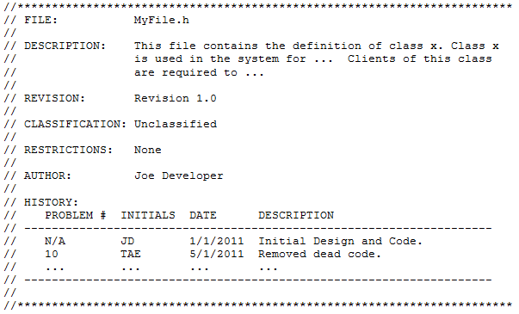
Software Construction using Styles
- Documentation Conventions -
Classified / Unclassified / Company sensitive / etc.
Who, why and when the file was changed?
Documenting files!

Slide 13
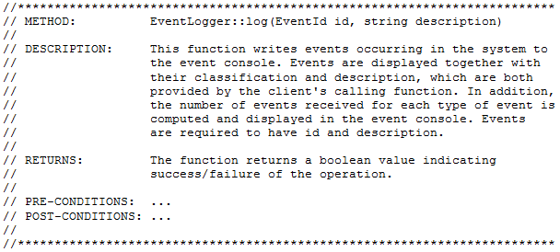
Software Construction using Styles
- Documentation Conventions -
Straight from the PDL!
Documenting functions!

Slide 14
Quality Evaluation of Construction Design
The construction design activity is the last major design step performed before construction. Therefore, it provides the last opportunity to evaluate the quality of the system to be built.
There are numerous project-specific quality characteristic (e.g., security, etc.) that can be identified and evaluated for construction designs.
  However, at a minimum, the design's completeness, correctness, testability, and maintainability should be evaluated, since these generally apply to all software projects.
Completeness and correctness deal with the degree to which construction designs correctly meet the allocated requirements.
  Construction designs that are correct, but incomplete, complete but incorrect, or incomplete and incorrect—those that do not meet all requirements, are incorrect, or both—need to be addressed and resolved to maintain the envisioned software quality of the product.

Slide 15
Quality Evaluation of Construction Design
- Correctness-
Completeness and correctness can both be evaluated through:
  Peer reviews
  Unit testing
  Audits
Peer reviews are tasks that concentrate on verifying and validating designs and code (i.e., design reviews and code reviews, respectively).
  Peer reviews must be planned, organized, and conducted in such way that a collective approval between all members of the project (with different disciplines) is reached.
Ultimately, the quality of construction designs in terms of completeness and correctness are evaluated through unit testing. Therefore, as construction designs are created, so are unit tests. One or more unit test cases are essential for verifying and validating construction designs.
  Unit test cases can be created straight from Use Cases!

Slide 16
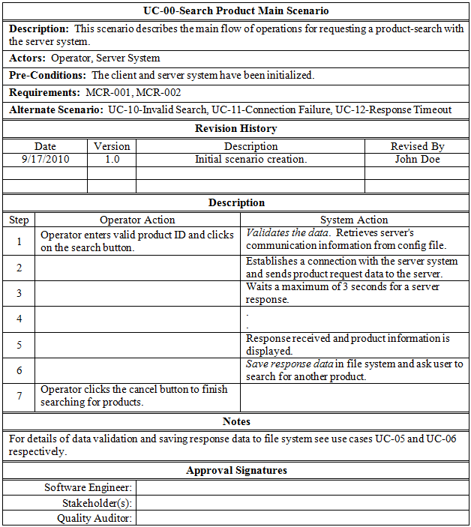
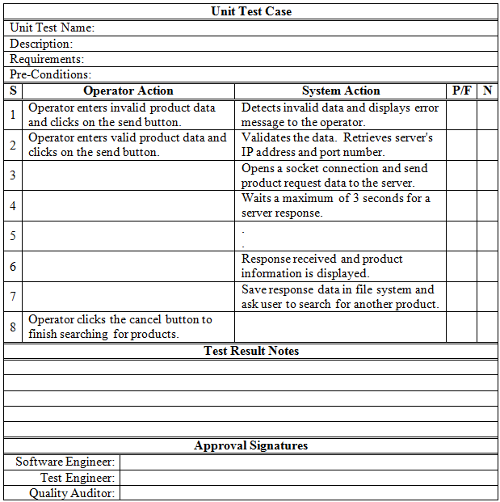
Quality Evaluation of Construction Design
- Unit Tests -
Sample Use Case Scenario from Chapter 3
Sample Test Case from Scenario

Slide 17
Quality Evaluation of Construction Design
- Testability and Maintainability -
Testability quality (in construction design) deals with the amount of effort required to test artifacts that are the result of construction design.
On the other hand, a design's maintainability quality deals with the amount of effort required to maintain a tested artifact that is the result of construction design.
Both testability and maintainability are goals that can be achieved in many ways, as determined by non-functional requirements of the project.
  A common approach for evaluating the testability and maintainability of construction designs include the measurement of the design’s cyclomatic complexity [1].
Testability and maintainability goals can be transformed into requirements that are based on the cyclomatic complexity.
  Maintainability quality can also be evaluated by the compliance of the resulting implementation of construction design to the programming style defined for the project.

Slide 18
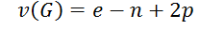
Quality Evaluation of Construction Design
- Cyclomatic Complexity -
Cyclomatic complexity is a technique developed by Thomas J. McCabe that can be used for evaluating the quality of flow-based designs.
It is a mathematical technique based on graph theory that provides a quantitative justification for making design decisions that lead to higher quality in terms of a design's maintainability and testability.
The cyclomatic complexity computation allows designers to measure the complexity of flow-based operational designs by determining the complexity of the decision structure of operations instead of lines of code.
The cyclomatic complexity technique works by computing the cyclomatic number v(G) of a graph G with n vertices, e edges, and p connected components, as seen in

Slide 19
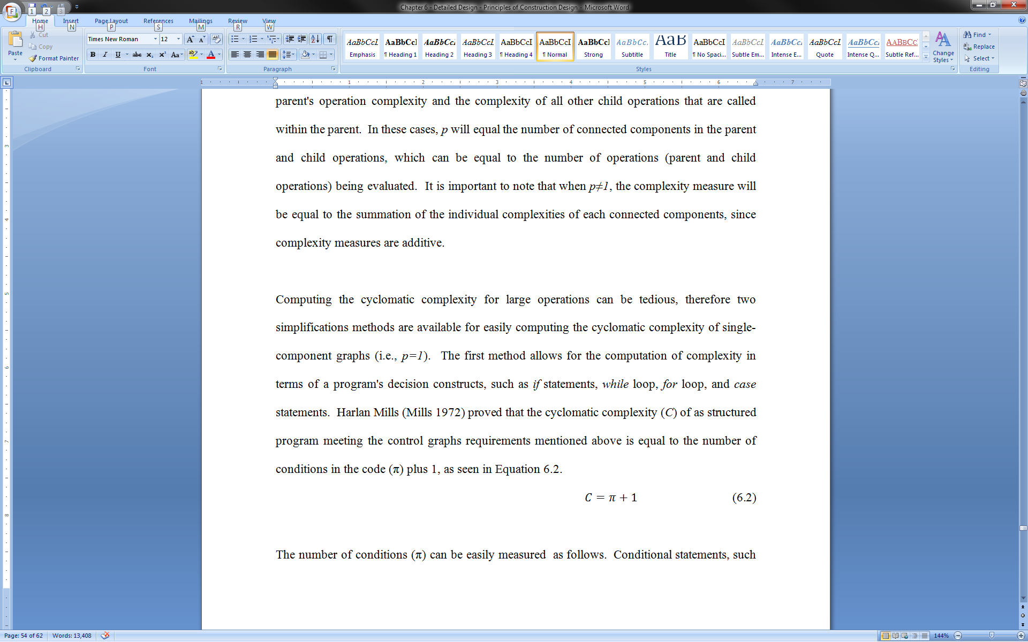
Quality Evaluation of Construction Design
- Cyclomatic Complexity -
Computing the cyclomatic complexity for large operations can be tedious, therefore two simplifications methods are available for easily computing the cyclomatic complexity of single-component graphs (i.e., p=1).
The first method allows for the computation of complexity in terms of a program's decision constructs, such as if statements, while loop, for loop, and case statements.
Harlan Mills proved that the cyclomatic complexity (C) of as structured program meeting the control graphs requirements mentioned above is equal to the number of conditions in the code (π) plus 1 [2], as seen in
  Where the number of conditions (π) is measured as follows:
    If, while, and for loops all count as one unit of complexity
    Compound conditional statements (e.g., if x and y) count as two units of complexity.
    Case statements containing n branches count as n-1 units of complexity.

Slide 20
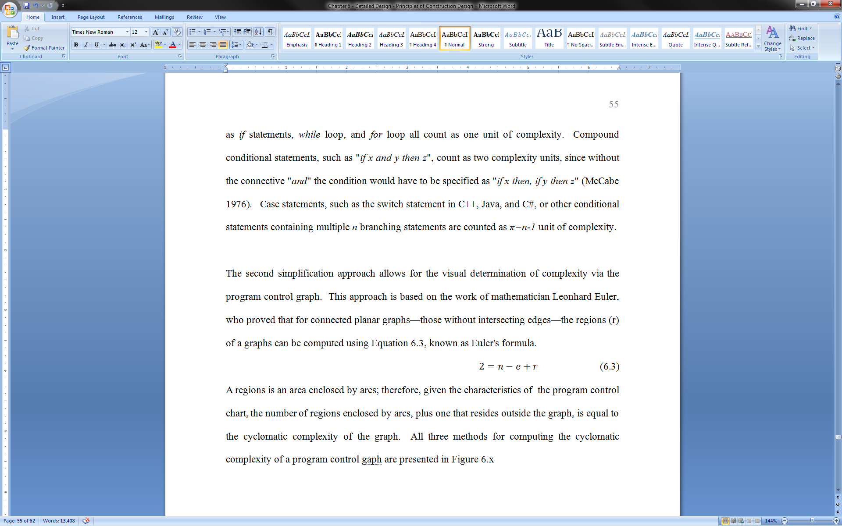
Quality Evaluation of Construction Design
- Cyclomatic Complexity -
The second simplification approach allows for the visual determination of complexity via the program control graph.
This approach is based on the work of mathematician Leonhard Euler, who proved that for connected planar graphs—those without intersecting edges—the regions (r) of a graphs can be computed using
A regions is an area enclosed by arcs; therefore, given the characteristics of the program control chart, the number of regions enclosed by arcs, plus one that resides outside the graph, is equal to the cyclomatic complexity of the graph.
Typically, a cyclomatic complexity value of 10 is acceptable, based on McCabe's work.

Slide 21
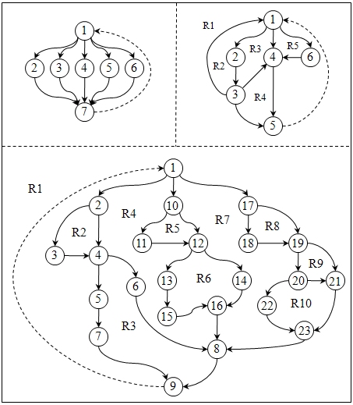
Quality Evaluation of Construction Design
- Cyclomatic Complexity -
First Program Flow:
  e = 10, n = 7, p = 1
  V(G) = e – n + 2p
  V(G) = 5 or
  C = π + 1
  For switch statement, π = n-1, π = 4, therefore,
  C = 5
Second Program Flow:
  r = 5
  Complexity = r + 1
  Complexity = 6
Third Program Flow:
  C = 11

Slide 22
Quality Evaluation of Construction Design
- Maintainability -
As stated before, maintainability quality can also be evaluated by the compliance of the resulting implementation of construction design to the programming style defined for the project. In many practical situations, where requirements have been established to meet a specific programming style, it can be time-consuming to read code line-by-line to validate that the code meets the style’s requirements.
  In these cases, the use of automated style checkers can provide significant benefits.
Automated style checkers (e.g., CheckStyle ) are tools that can be configured to enforce a specific style of programming. Some of the capabilities included by these tools include:
  Naming conventions of attributes and methods
  Formatting conventions
  Limit of the number of function parameters, line lengths
  Comments (Javadoc) for classes, attributes and methods
  Presence of mandatory headers
  Good practices for class design
  Checks for duplicated code sections
  Checks cyclomatic complexity against a specified threshold
  Other multiple complexity measurements

Slide 23
What’s Next…
In this session, we continued the discussion on construction design, including:
  Programming Design Language
  Construction (Programming) Styles
    Formatting
    Naming
    Documentation
  Quality Evaluation of Construction
    Completeness
    Correctness
    Testability
    Maintainability
  McCabe’s Complexity Theory
    Used to evaluate testability and maintainability
This concludes the presentation of construction design. In the next module, we will present an introduction to another very important form of design, human-computer interface design.

Slide 24
References
[1] McCabe, Thomas J. “A Complexity Measure.” IEEE Transactions on Software Engineering SE-2, no. 4 (1976):308-320.
[2] Mills, Harlan D. Mathematical Foundations for Structured Programming. Gaithersburg, MD: IBM Federal Systems Division, IBM Corporation, 1972.

